Slide 1
SocialHike
Group 2:
Anthony Tolentino, Mike Nutile, Kristina Im, Jake Day
Notes:
SafeWalkers:
Introduction
Scheduling
Network Diagram
Interviewers
UML Diagrams Overview
Use Case
Activity Diagram
Class Diagram
System Sequence Diagram
State Machine Diagram
User Interface Design
Cost Benefit Analysis
Conclusion
(~45s per slide)
Roomie:
Introduction
Use Case Diagram
Activity Diagram
System Sequence Diagram
Class Diagram
State Machine Diagram
UI Design
Cost Benefit Analysis
(~1m 15s per slide)

Slide 2
Introduction
Stakeholders:
Hikers, Customer service
Problem:
Solo hiking can be dangerous
Hiking app alternatives are not socially oriented
Opportunity:
Current competitors focus on the individual, we want to focus on hiking as a group/with others
Existing meet up apps are broad and too generalized
Notes:
M

Slide 3
Scheduling
Iteration | Time Estimate | Use cases assigned to iteration
1 | 2 months | Project Design 1.1 Start project 1.2 Conduct focus groups - better understand the market 1.3 Research hike trails, maps, GPS, topographic maps - research other competitors (existing apps) to benchmark 1.4 Create diagrams to better understand the system and moving components
2 | 2 months | Project Planning 2.1 Determine scope of the project 2.2 Budget for the project 2.3 Determine pricing strategy for the app 2.4 Determine required resources (ex: talent, outsource?)
3 | 6 months | Project Initiation - Build out the app 3.1 Hire software developers, graphic designers, UI/UX designers 3.2 Decide on a platform for the app (ex: iOS, Android) 3.3 Software developers write code for the app system 3.4 Graphic designers/UI/UX designers create user interface
Notes:
M

Slide 4
Scheduling
Iteration | Time Estimate | Use cases assigned to iteration
4 | 3 months | Project Implementation 4.1 Market to hikers 4.2 Launch app 4.3 Use social media influencers as ambassadors for the app (more exposure and marketing)
5 | 3 months | Project Monitoring 5.1 Test and monitor app 5.2 Ongoing optimization and maintenance
6 | 1 month | Project Closure 6.1 Present to stakeholders 6.2 Lessons learned 6.3 End project
Total | 17 months
Notes:
M

Slide 5
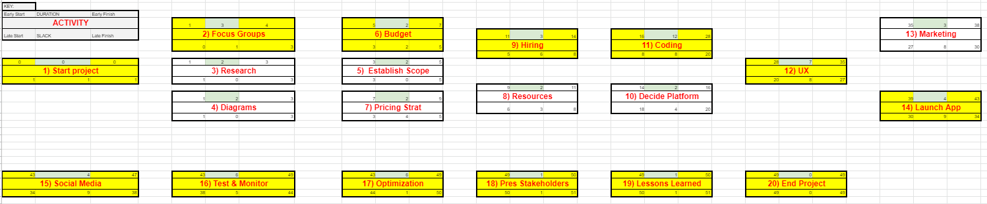
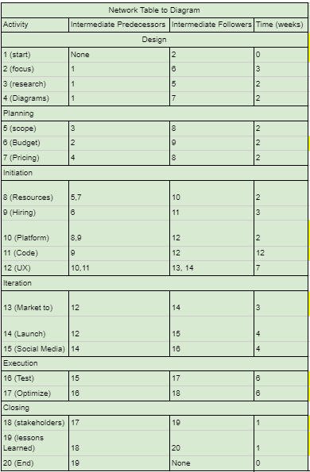
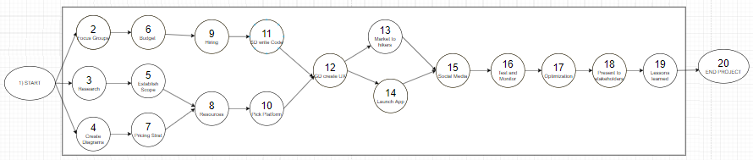
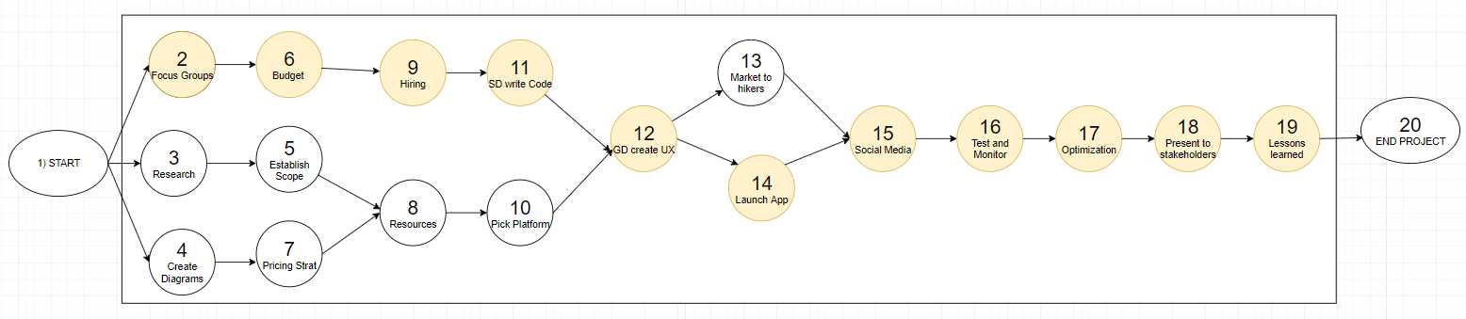
Network Diagram
Which tasks are important?
Notes:
M

Slide 6
UML Diagrams Overview
Use case diagram
Minimal actors but many potential use cases
This diagram describes the customer account subsystem
Activity diagrams
Shows when a user searches for a group/hikers and creating an account
Class diagram
Shows naturally occurring relationships like Group Preferences & Hike Group
System sequence diagram
Depicts the sequence of events when a user searches for a group/hikers
State machine diagram
Shows the different states of a ”hiking group“

Slide 7

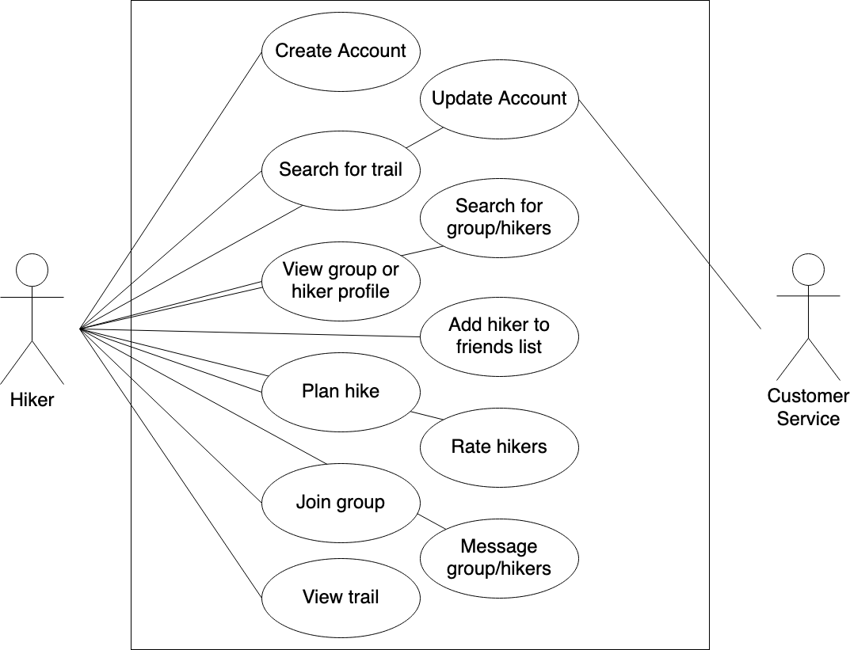

Use Case
Why should the App be built?
What does the App do?
Information gathering:
Researched competitors and interviewed known hikers and asked them what they like about hiking, why they hike, and any pain points of existing apps.
Results:
Majority of hikers and comments preferred social aspects of hiking (chatting, group hiking, making friends)
Notes:
Search for group/hikers includes search for trail
Search for group/hikers can include message group/hikers
Search for group/hikers can include view group or hiker profile?

Slide 8
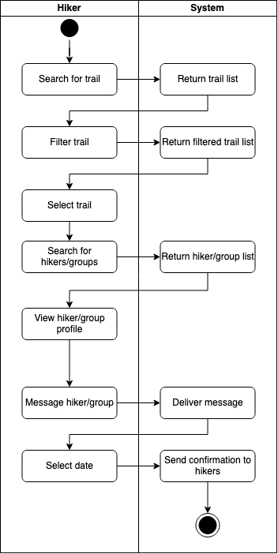
Activity Diagram - Search for group/hikers
What does the App do?
The flow between the hiker and the system is mapped out for group hiking. This is important to understand the hiker’s process and input as they use the app to search for hiking groups, chat with friends, and meet other hikers

Slide 9
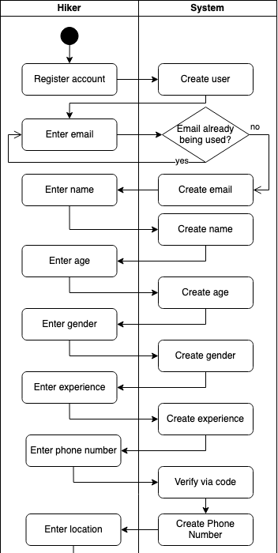
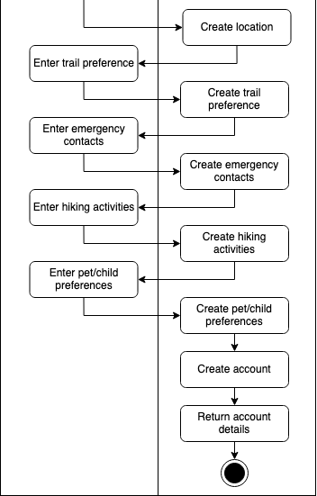
Activity Diagram - Create Account
How creating an account functions
The flow between the hiker and the system is mapped out when creating an account. This is important to understand the hiker’s process and input as they create an account. Likewise we can understand the system requirements in a straightforward and easy to understand manner

Slide 10
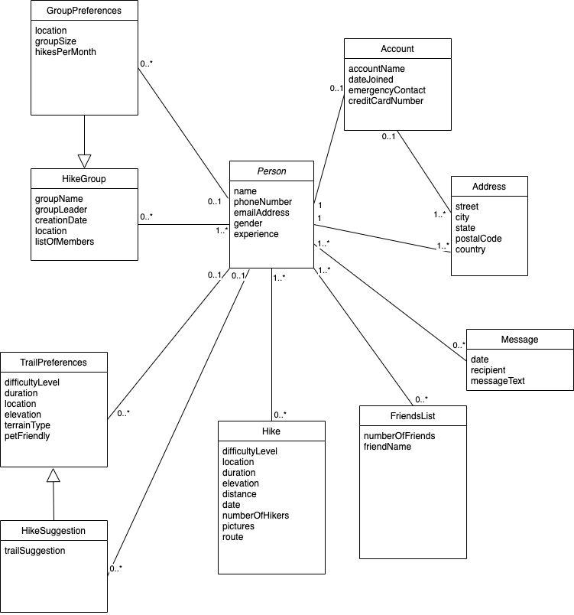
DOMAIN Class Diagram
Class: category or classification used to describe a collection of objects
Domain Class Diagram: displays the attributes and association among the domain classes
Generalization/specialization relationships:
GroupPreferences is a special type of Hike Group
HikeSuggestion is a special type of TrailPreferences
Notes:
Kristina
Generalization and specialization relationships - the notion that things are classified in terms of similarities and differences (this is indicates hierarchical relationships)

Slide 11
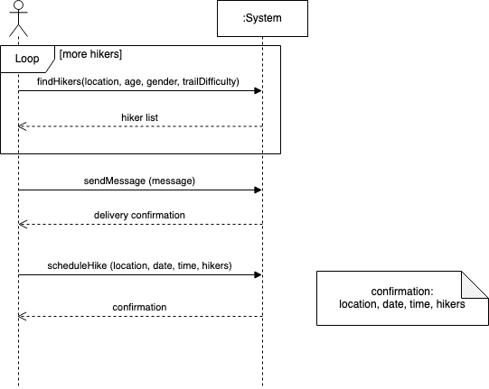
System Sequence Diagram - Search for group/hikers
The SSD describes the flow of information into and out of the automated portion of the system. It is effective in identifying the the specific information that flows from the user into the system and the information that flows out of the system back to the user.
IN: input message by the user (location, age, gender, trailDifficulty)
OUT: list of hikers
Notes:
Kristina
The diagram above clearly illustrates the actor/system object lifeline when searching for groups and hikers. The system provides hiker lists, delivery and schedules confirmation while the hiker finds groups, sends messages and schedules hikes.

Slide 12
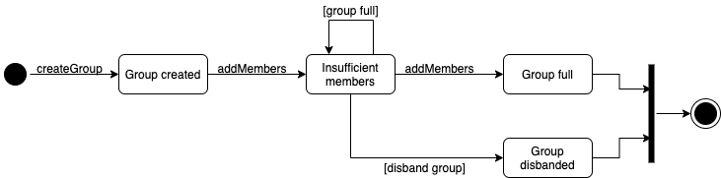
State Machine Diagram
State: condition that occurs during its life when it satisfies some criterion, performs some action, or waits for an event
The State Machine Diagram shows the life of a hiking group in the following states: accepting members, full capacity and group disbandment.
Notes:
Kristina
Groups were chosen due to the integration of the killer user case as determined in the information gathering and use case sections. This reinforces the importance of integrating requirement models.

Slide 13
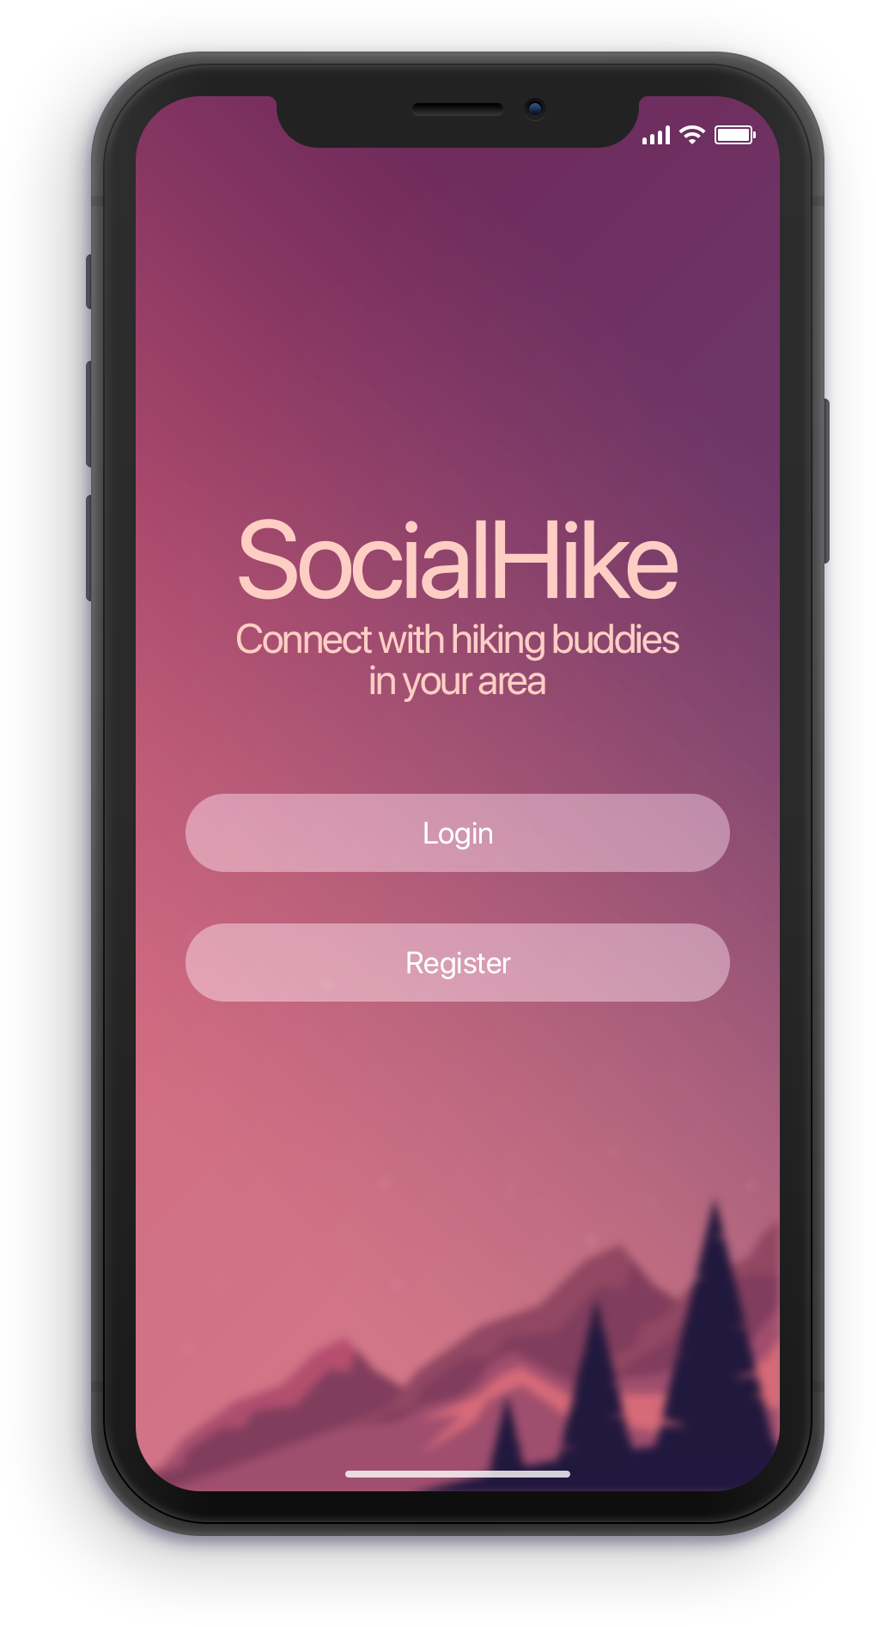
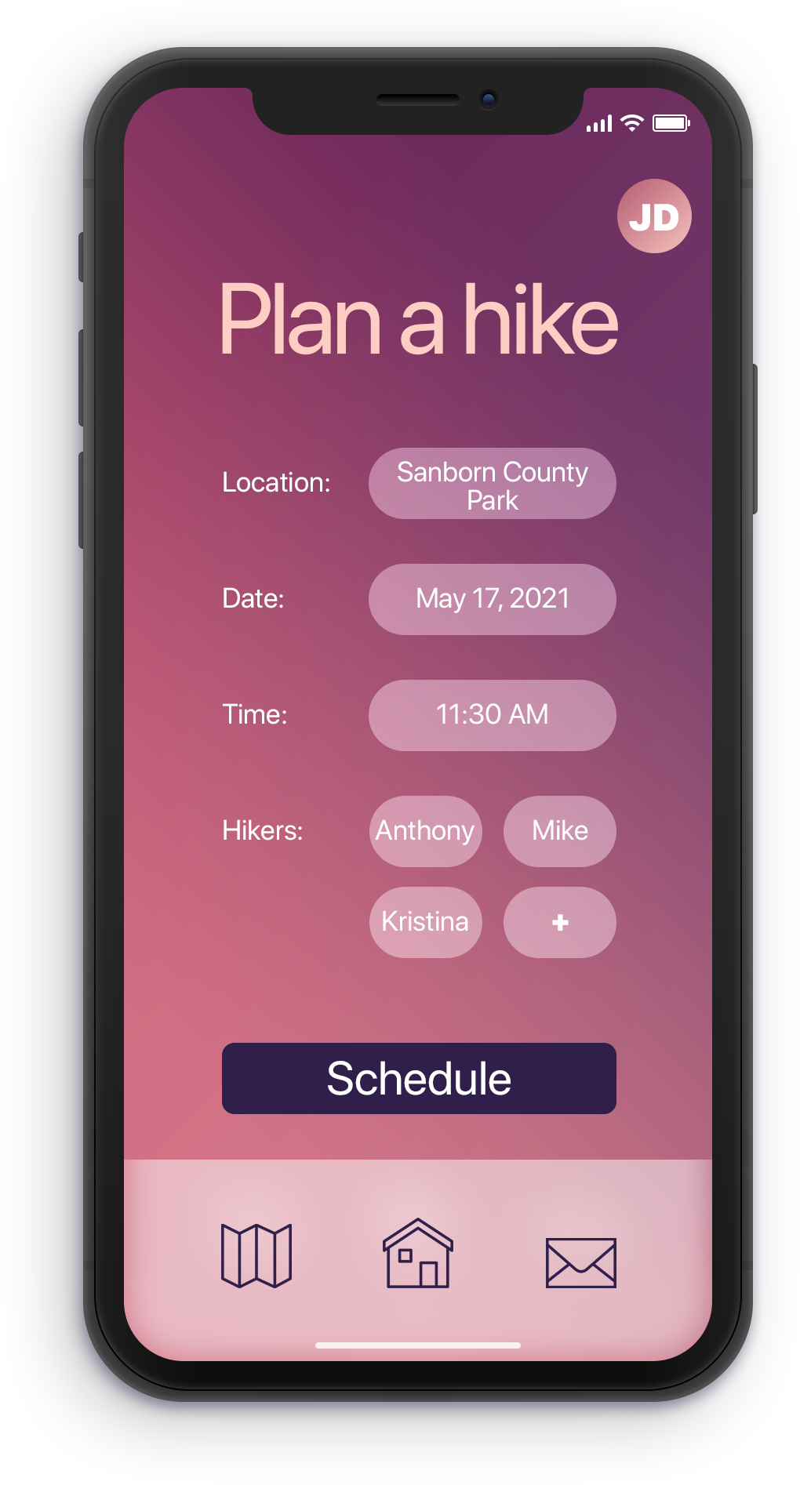
User Interface Design
Consistent
Simple layout + design
Affordance
Notes:
Kristina
Left: Landing page
Log into existing account or register for an account
Right: Plan a hike use case
Accessible after logging in
Top right: quick access to user account page
Bottom navbar: maps (offline maps), home (home page), envelope (messages)
**Customer focused: Emphasize readability of text, shortcut icons {for advanced users}, easy to find home button [a way out], Kept simple

Slide 14
Cost Benefit Analysis
Year | 0 | 1 | 2 | 3 | 4 | 5
Cost
Analysis, design, implementation | $ (100,000.00)
Operation and maintenance |  | $ (20,000.00) | $ (20,000.00) | $ (20,000.00) | $ (20,000.00) | $ (20,000.00)
Total Costs | $ (100,000.00) | $ (20,000.00) | $ (20,000.00) | $ (20,000.00) | $ (20,000.00) | $ (20,000.00)
Discount Factor (10%) | 1.00 | 0.91 | 0.83 | 0.75 | 0.68 | 0.62
Present Value of Costs | $ (100,000.00) | $ (18,181.82) | $ (16,528.93) | $ (15,026.30) | $ (13,660.27) | $ (12,418.43)
Cumulative PV of Costs | $ (100,000.00) | $ (118,181.82) | $ (134,710.74) | $ (149,737.04) | $ (163,397.31) | $ (175,815.74)
Benefit
Tangible Benefits from new system |  | $ 75,000.00 | $ 75,000.00 | $ 75,000.00 | $ 75,000.00 | $ 75,000.00
Total Benefits | $ - | $ 75,000.00 | $ 75,000.00 | $ 75,000.00 | $ 75,000.00 | $ 75,000.00
Discount Factor (10%) | 1.00 | 0.91 | 0.83 | 0.75 | 0.68 | 0.62
Present Value of Benefits | $ - | $ 68,181.82 | $ 61,983.47 | $ 56,348.61 | $ 51,226.01 | $ 46,569.10
Cumulative PV of Benefits | $ - | $ 68,181.82 | $ 130,165.29 | $ 186,513.90 | $ 237,739.91 | $ 284,309.01
Cumulative PV of Benefits+Cost | $ (100,000.00) | $ (50,000.00) | $ (4,545.45) | $ 36,776.86 | $ 74,342.60 | $ 108,493.27
Notes:
Tried 6 strategies:
Baseline
RAD (rapid app development)
JAD (joint app development)
Baseline5
RAD5
JAD5
Average cost of developed a mobile app around $100k
Maintenance should be ~20% of development cost
Assumed a 10% discount factor
Estimate around $75k in tangible benefits, annually
Premium features, $15/year (half of alltrails)
Assume ~5k premium users
Intangible benefits of social aspect, community

Slide 15
Cost Benefit Analysis
1. Payback | 1.818 | years
2. IRR | 61.71% | over lifetime
Annual IRR | 20.57% | per year
3. NPV | $108,493 | since >0, feasible
4. Profitability Index | 2.84 | since >1, feasible
Notes:
A little less than 2 years to payback
High IRR
Net present value is over 0, so the project is feasible
Profitability index is greater than 1, so also feasible

Slide 16
Cost Benefit Analysis
Strategy | Payback | Payback Rank | IRR | IRR Rank | Annual IRR | Annual IRR Rank | NPV | NPV Rank | Profitability Index | Profitability Index Rank | Mean Rank
Baseline | 1.818 | 2 | 24.56% | 4 | 8.19% | 4 | $36,777 | 4 | 1.87 | 5 | 3.8
RAD | 2.034 | 4 | 20.64% | 5 | 6.88% | 5 | $31,908 | 5 | 2.33 | 4 | 4.6
JAD | 2.282 | 5 | 18.57% | 6 | 6.19% | 6 | $29,211 | 6 | 1.55 | 6 | 5.8
Baseline5 | 1.818 | 2 | 61.71% | 1 | 20.57% | 1 | $108,493 | 1 | 2.84 | 2 | 1.4
RAD5 | 1.631 | 1 | 46.76% | 3 | 15.59% | 3 | $90,585 | 3 | 3.55 | 1 | 2.2
JAD5 | 2.282 | 5 | 60.75% | 2 | 20.25% | 2 | $107,447 | 2 | 2.37 | 3 | 2.8
Notes:
Compare all metrics between potential strategies
5 year strategies scored the highest overall
Opted for Baseline since JAD has higher risk and RAD has lower IRR and NPV
Net present value
Internal rate of return

Slide 17
Conclusion
Social Hike
Why make the App? [Interviews & Use Cases]
Hikers want a socially oriented hiking platform.
What does the App do? How does the App Function? [UML Diagrams]
Stakeholder information:
~12 months to release; ~17 months to complete
NPV ~$37k baseline
NPV ~$108k in five years lifespan
Social Hike has the potential to be the next killer-app for hiking.
Notes:
Why make the app?
Focus group questions
A majority of hikers preferred the experience of sharing a hike and social aspects of hiking. In short, the social aspect of hiking [chatting, group-hiking, making-friends] makes for a killer use case.
One of the top reasons for failure at-market is due to poor planning and lack of strategy
By going through the full System Analysis and Design (SAD) process of app development, we hope to be able to address the issues and plan for unexpected turning points in development
Each of our UML diagrams as well as the network diagram helps us to answer questions about the functionalities of the app as well as identify goals and early insights
We believe addressing these issues will ensure the success of our app, SocialHike.

